Slide 1
A Novel Packetized Display protocol Architecture for Infrared Scene Projectors
By Aaron Landwehr
Committee: Dr. Fouad Kiamilev, Dr. Chase Cotton,
Dr. Xiaoming Li, and Dr. Stéphane Zuckerman

Slide 2
Outline
Introduction to IRLED Scene Projector Systems
History of My Academic Career
Challenges of High Speed IRLED Projection
A Packetized Display Protocol (PDP) Architecture for IRLED Projection

Slide 3

Introduction to IRLED Scene Projector Systems

Slide 4
Infrared Scene Projectors (IRSP)
Used to test infrared guidance systems
Must be able to produce room-temperature and hot scenery simultaneously
Higher maximum apparent temperature is almost always better
Ideally at least as fast/high resolution as the sensors (preferably twice as big as the sensor)
Often used in real time simulations

Slide 5
Established IRSP technology
Resistor arrays (black-body emitters)
Advantages
Well established
Stable
Spectrally accurate
Disadvantages
Limited maximum temperature (~800K)
Limited potential to scale beyond 48µm and therefore resolutions above 1024x1024
Limited maximum speed due to cool-down
Can be easily damaged with poorly controlled scenery
Must be optically combined to produce separately controlled wavelengths
Optical rise time of few milliseconds

Slide 6
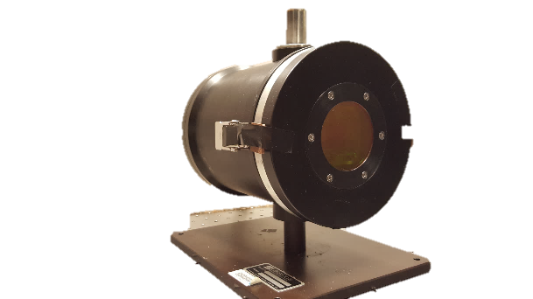
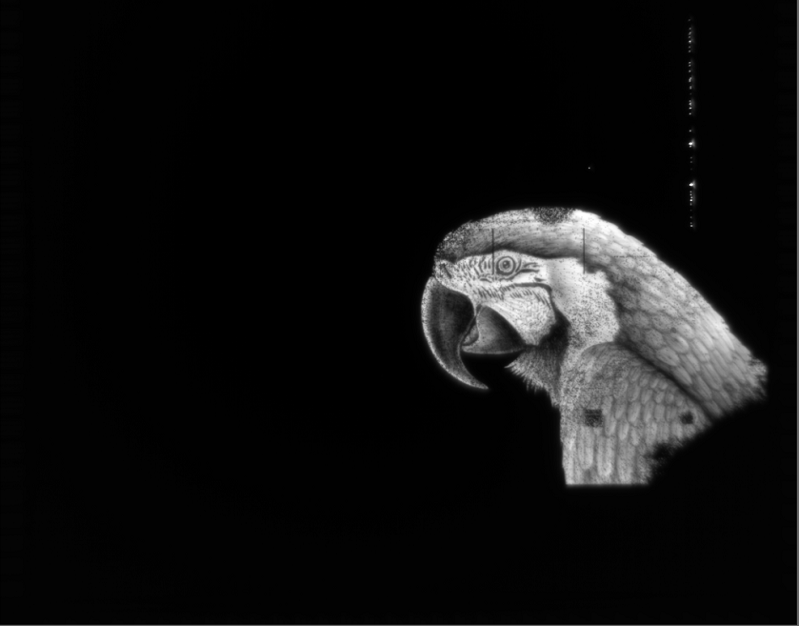
Super-Lattice Light-Emitting-Diode (SLED) based IRSP
Very high apparent temperature (1400K+)
High density (24µm now, 12µm or smaller in the future)
Inherently Fast, limited primarily by the electronics
Relatively difficult to damage thermally
Multi-color pixels possible
Optical rise time in nanoseconds

Slide 7
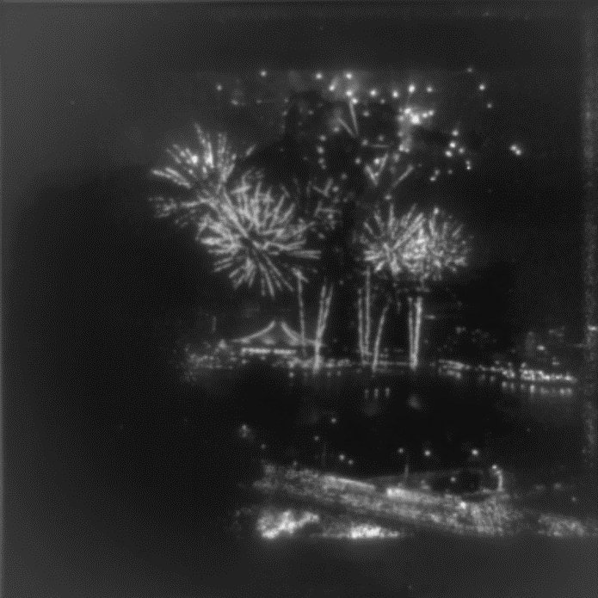
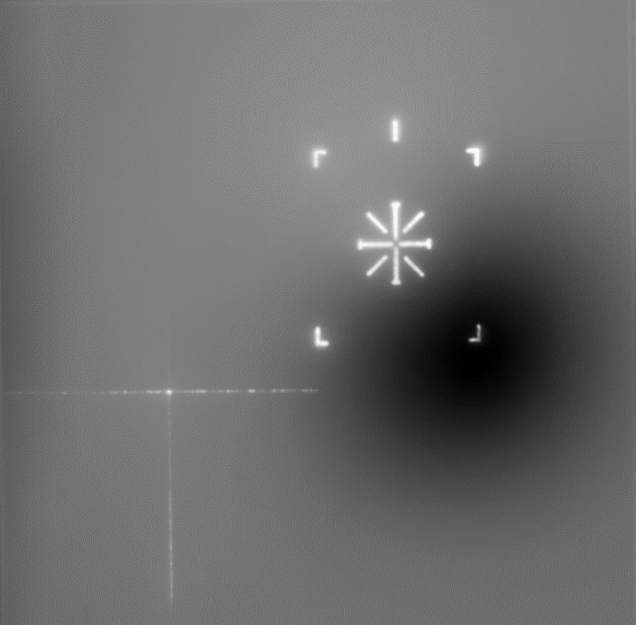
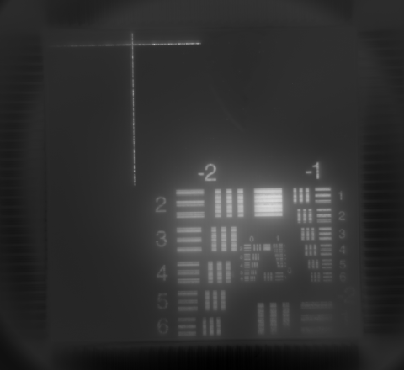
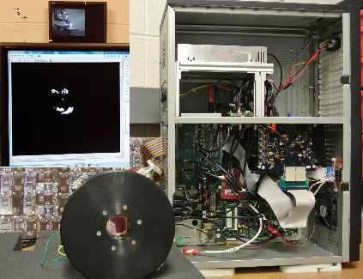
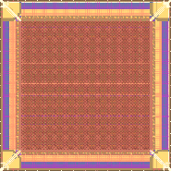

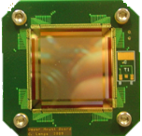
Superlattice LEDs (SLEDs) Projectors
Projector with 512 x 512 2-color SLEDs array
Projector with 2K x 2K SLEDs array
512 x 512 SLEDs array + RIIC +
System to drive array
64 x 64 SLEDs array + RIIC
System to drive SLEDs array
Projector with 1K x 1K SLEDs array
2008 | 2011 | 2014 | 2016 | 2018
Notes:
Finally, in 2018, the team built the 2k x 2k projector. Complete characterization of the systems is ongoing, and having a system capable of running each of the projectors still under development has been key to performing that characterization.

Slide 8

History of My Academic Career

Slide 9
Brief History of My Academic Career

Slide 10

Academic Career Cont.
My academic career has focused on
Bare-metal runtime systems and program execution models (PXMs)
Optimization for low-level exa-scale architecture
Dynamic/Static adaptation for power/performance/resiliency
How does this relate to IRLED scene projection?
Hard requirements:
Frame-rate → Khz performance
Latency →sub-frame latency requirements
Synchronization → dynamic + end-to-end

Slide 11

Challenges of High Speed IRLED Projection

Slide 12
State of the Art for High Performance Scene Projection
Display Protocols
DVI/HDMI 1.1
Synchronization
Hardware Synchronization Cards
Custom Hardware solutions requiring specific hardware for the entire end-to-end system

Slide 13
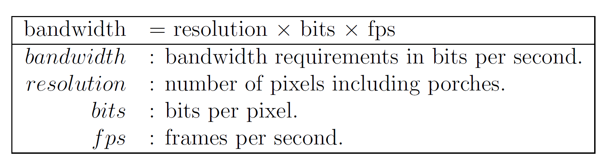
Limitations
Display Protocols
Frame-rate limits → image size inversely proportional to speed
Static Bandwidth Requirements → full image transfer
Static frame-rates → 60hz, 100hz, etc.
Scalability → single scene generator, projector driver
Synchronization
Implementation and integration-costs
System-specific solutions
Poor upgradeability
Analog Chain
RT settling time limitations
Can we do better?
512X512@100hz
512X512@100hz
512X512@100hz
Scene-Generator
Non-Uniformity Correction
Projector

Slide 14
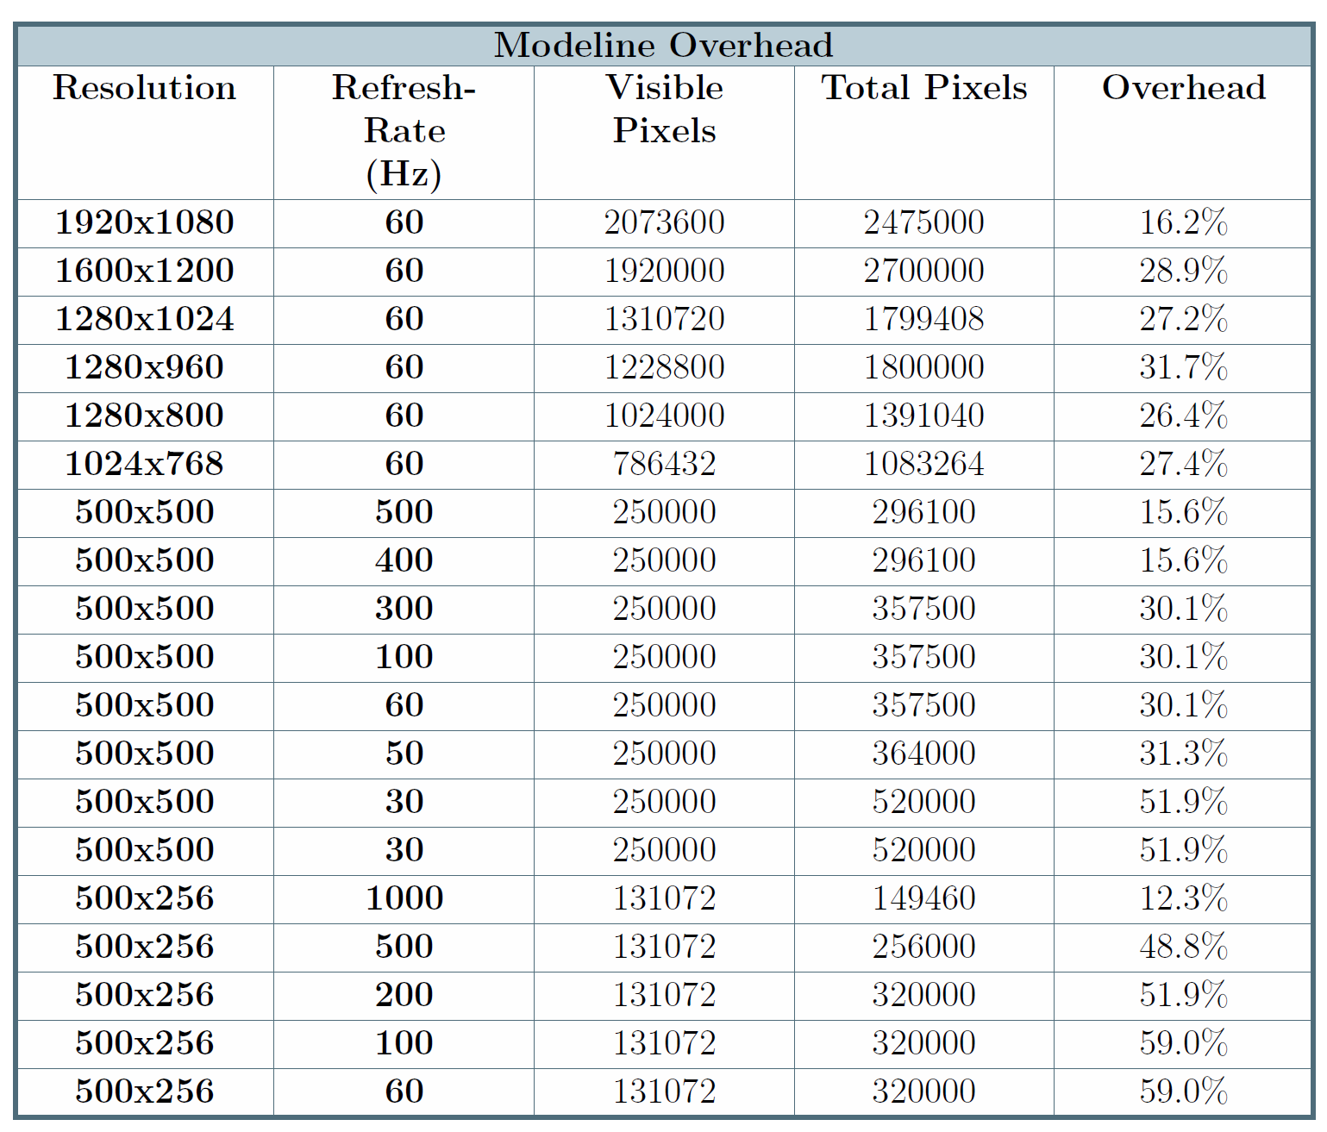
Limitations Continued

Slide 15
Problem Formalization
How to architect a dynamic scalable IRLED projection end-to-end system capable of
High-performance operation
Sub-frame latency
Dynamic frame-rates
Intelligent Bandwidth utilization
Intelligent DAC utilization
Upgradeability / Generalizability

Slide 16

Bottlenecks
Hardware limitations
Physical interconnect bandwidth and latency
FPGA/ASIC/IC clock rates
Analog chain settling times (DAC)
Software limitations
Computational/algorithmic limitations
Poorly optimized software / drivers
Fixed-frame display
Non-RT scheduling
Lack of control

Slide 17
Bottlenecks
Hardware limitations
Physical interconnect bandwidth and latency
FPGA/ASIC/IC clock rates
Analog chain settling times (DAC)
Software limitations
Computational/algorithmic limitations
Poorly optimized software / drivers
Fixed-frame display
Non-RT scheduling
Lack of control
Concurrency/Parallelization
Concurrency/Parallelization
Address only the pixels needed
Concurrency/Parallelization
Don’t use
Dynamic framerate + frame segmentation
Realtime schedule / DMA
Use a communication protocol with dynamic control built in

Slide 18
Toward a Problem Solution
How to architect a dynamic scalable IRLED projection end-to-end system capable of
High-performance operation → Control over bandwidth utilization and computation
Sub-frame latency → Control synchronization
Dynamic frame-rates → Control the sending of pixels/data
Intelligent Bandwidth utilization → Send only pixels needed
Intelligent DAC utilization → Address only pixels needed
Upgradeability / Generalizability → Don’t tie design to specific hardware

Slide 19
Proposed Solution: Packetized Display Protocol (PDP) Architecture
Summary:
A physical layer agnostic method of pixel data transmission capable of providing and addressing latency guarantees while maximizing bandwidth utilization
Capable of
Fine-grained control over frame transmission and synchronization
Dynamic changing frame-rates from frame-to-frame
Dynamic sub-frame framerates
Diagnostic Information (timing constraints, etc.) allowing timing isolation
Extensibility
Fast decoding/processing
Random Access Writes
Aspects
Communication layer + Organization layer

Slide 20

A Packetized Display Protocol (PDP) Architecture for IRLED Projection

Slide 21
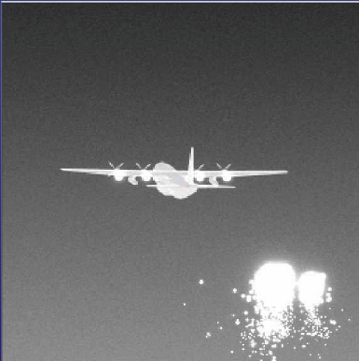
Typical IRLED Projection System
100hz
All components operate at the same speed
100hz
100hz
100hz
Scene-Generator
Non-Uniformity Correction
Projector

Slide 22
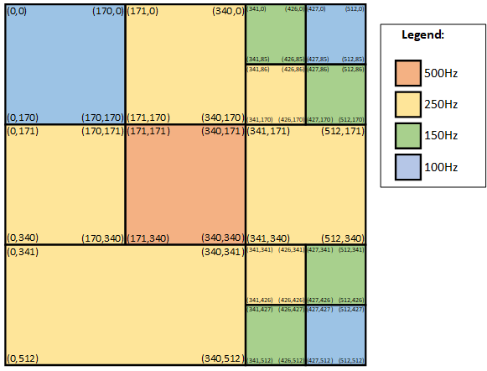
Alternative: Frame Segmentation
Slice frames into regions
Variable framerates

Slide 23
Frame Segmentation Cont.
Red operates at 500hz
Blue operates at 20hz
Intelligent Bandwidth utilization
Need to define system components and interactions
→ Abstract Machine Model

Slide 24
Abstract Machine Model
AMM
Abstract hardware representation of a system organizing a system into layers each providing a set of services
Requirements
Scalable
Captures hardware components without limiting the design to specific hardware
Functionally equivalent to classical IRLED system

Slide 25
AMM Components
Scene Generator
Creating a scene
Internal computational and bandwidth limitations
Compositor
Non-uniformity correction & Array data formatting
Compositing (combining of image data, segmenting of image data, etc.)
Internal computational and bandwidth limitations
Projector Tile
Displaying pixel data
Internal computational and bandwidth limitations
Communication Links
Interfaces data transfers over
Bandwidth limitations

Slide 26
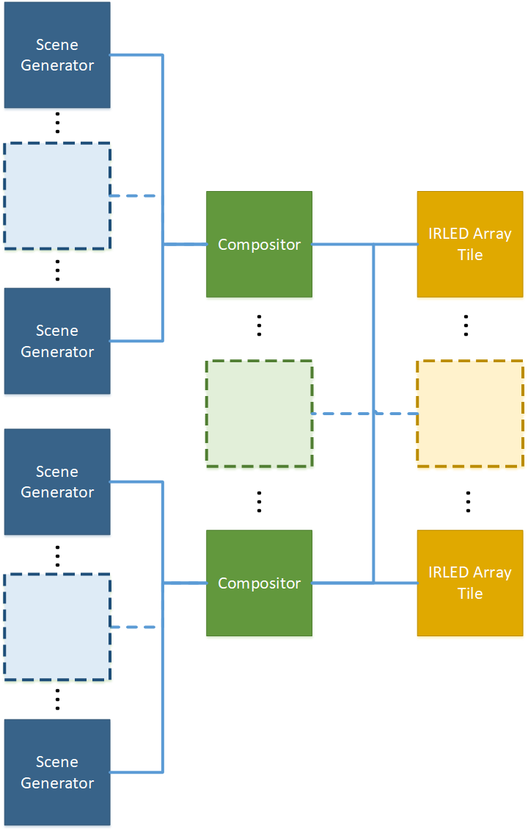
PDP Abstract Machine Model
Component breakdown:
1 to N Scene Generators
1 to M Compositors
1 to P Projector Tiles
Benefits
Scalability
Distributed
Generalizable

Slide 27
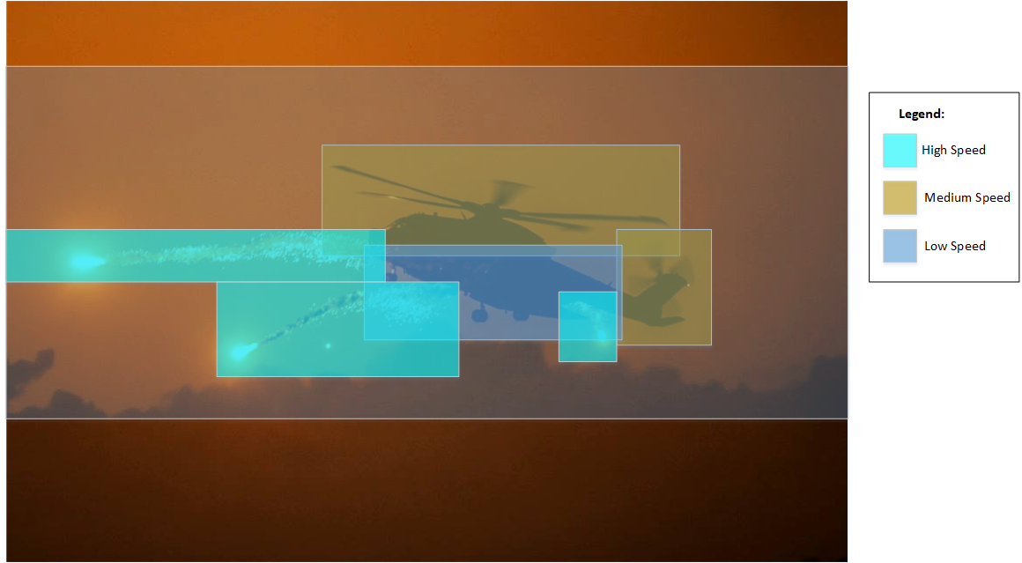
Example Operation
Video of Data (generated in parts or as a whole)
Segment frames into sub-frames
Each with variable frame operation

Slide 28
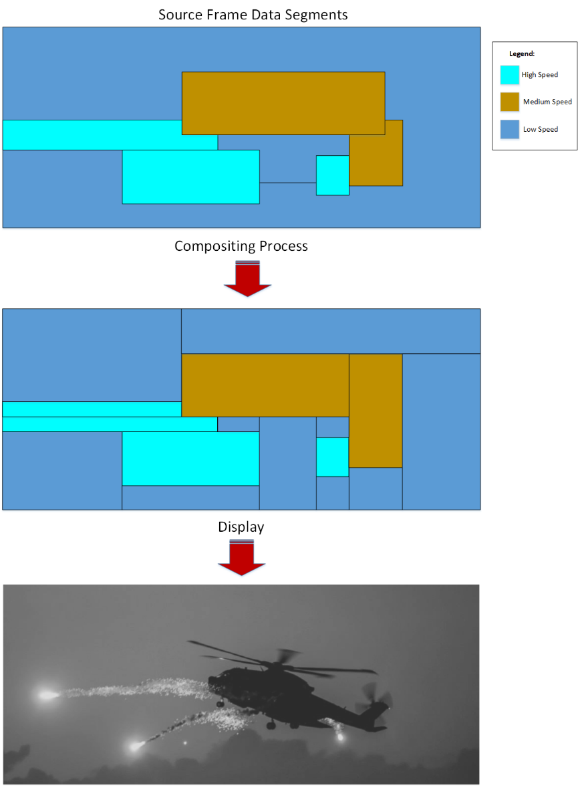
AMM Operation: simplified case
Generate and send frame data
In whole or parts
Composite frames and segmenting them
Change delta of frames
Relying on scene-generator to provide annotated priorities
Sending and displaying data in RA-ordering

Slide 29
Benefits
Efficient intelligent bandwidth utilization
No longer limited to HW bandwidth
Efficient DAC timing
No longer need to assume worst-case (whole frame) timings for DAC operation
Dynamic high frame-rate operation
Computation is cheap and parallelizable
Control
We retain control over when how data moves without being tied to specific hardware

Slide 30
PDP communication protocol
Requirements
Fast decode/process
Low-overhead
Command oriented
Packet types
Pixel data packets
Synchronization packets
Debug packets
Etc.

Slide 31
Packet Details
Minimize what we need
Possible Solutions
X, Y, Size, Variable pixel data format
X start, X end, Y start, Y end, Variable pixel data format
Consider the sizes of each field and resolutions
Efficiency
Considerations
Byte alignment: Most computer architectures and HW use at-least 8-bit alignment for ISA and bus widths
Computations/Comparisons needed

Slide 32
Packet Considerations
Fix-width fields
simplify decoding/processing HW and implementation
WORD size >= 2^16, assume power of 2
65536 by 65536 array size
Need to consider pixel resolution as well
Simplify operations through alignment
Region: X start, X end, Y start, Y end
Utilize a single unified coordinate system → minimize translations
Reduce computational complexity in HW and compositor
Avoid 2N² additional comparisons for compositing (for translation)
Remove unneeded computations in back-end

Slide 33
Implementation: Reducing Complexity
Doesn’t violate our AMM
Pretty Simple: Maps to what we have currently

Slide 34
Prototype implementation
How
Let’s use HDMI as a transport layer for our protocol
Design Custom mode-lines to minimize overhead
We already have hardware and software for this
Details
Use a small mode line to transfer data
Define WORD size as 24-bit (since HDMI uses 24-bit)
Name | Type ID | Type Specific Fields
From Stream | 0x0
Draw Region | 0x1 | X start | X End | Y Start | Y End | Data…
Array Reset | 0x2
Wait until Vsync | 0x3

Slide 35
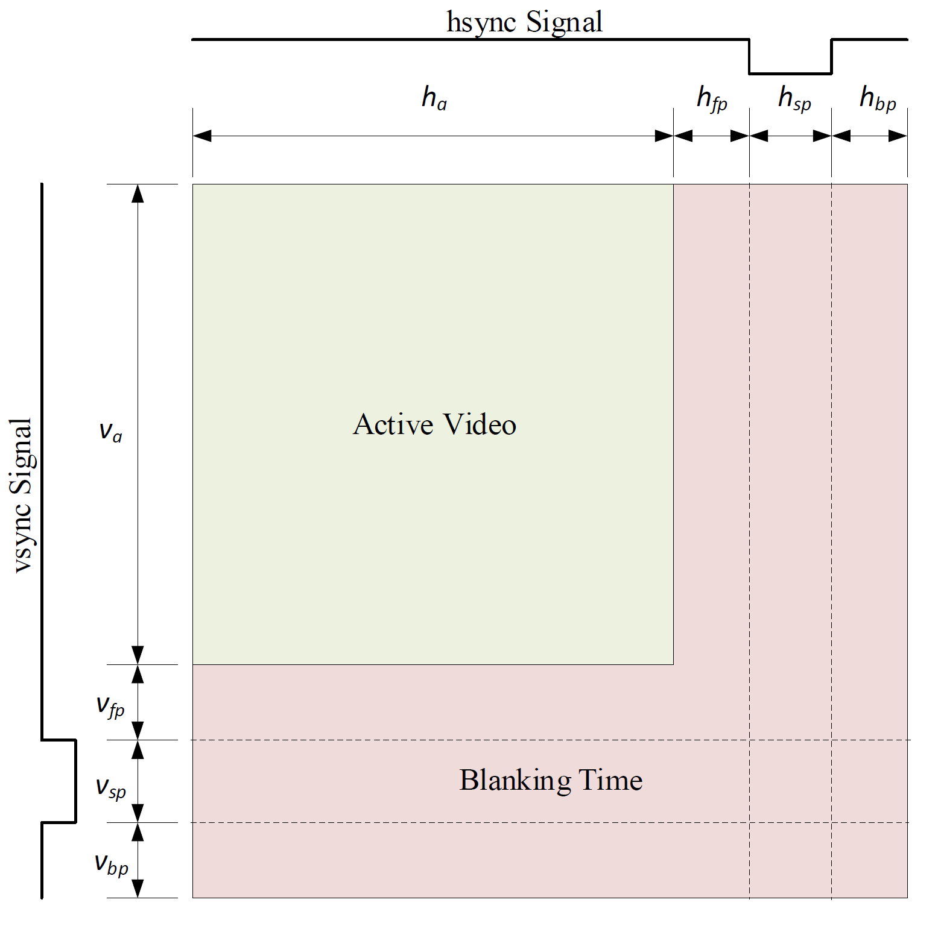
HDMI Data

Slide 36
Classic Active Video Frame
D
D
D
D
D
D
D
D
D
D
D
D
D
D
D
D
D
D
D
D
D
D
D
D
D
D
D
D
D
D
D
D
D
D
D
D
D
D
D
D
D
D
D
…

Slide 37
Packet Refresher
Draw_Region
Type: 0x01
X_Start
X_End
Y_Start
Y_End
Data
Data
…
1
XS
XE
YS
YE
D
D
D
…

Slide 38
PDP Embedded Frame
1
XS
XE
YS
YE
D
D
D
D
1
XS
XE
YS
YE
D
D
D
D
D
D
D
D
D
1
XS
XE
YS
YE
D
D
D
D
D
D
D
D
D
1
XS
XE
YS
YE
…

Slide 39



Ultimate Goal
Send small fast frames at fast framerate
Decode these and display them anywhere on the array in RA (random access) order with differing framerates
Array Emitter
Small Data Frame (not to scale)
1
XS
XE
YS
YE
D
D
1
High Speed
XS
XE
YS
YE
D
D
D
D
Low Speed
1
XS
XE
YS
YE
D
D
D
Low Speed
Low Speed

Slide 40
Arbitrary Packets
Features
Dynamic Frame-rate
Arbitrarily sized N sub-packets.
Note these regions can change framerate across frames

Slide 41
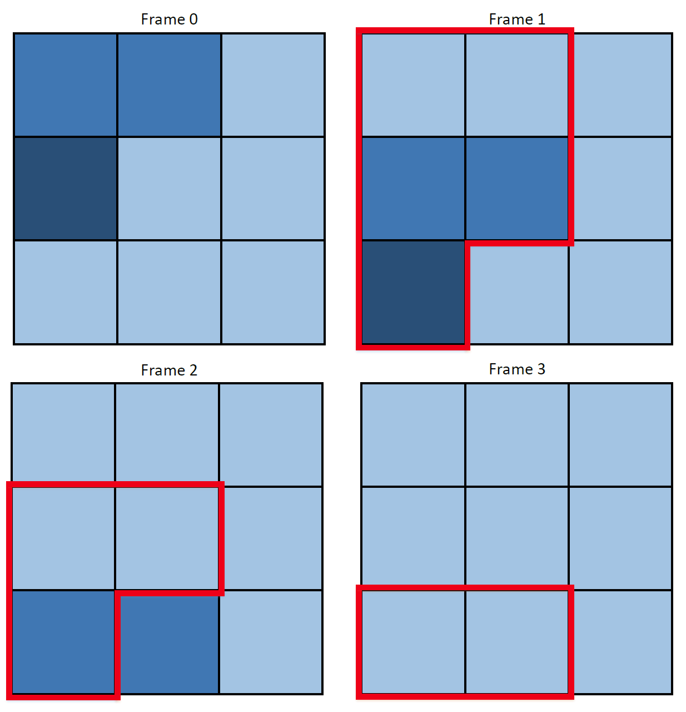
Intensity changes

Slide 42
Mapping PDP to projector hardware
Requirements
Decoupling from a fixed framerate
Current assumptions
Fixed DAC time based off of input clock (pixel clock)
This is bad
How do we get around this?

Slide 43
Abstract Firmware Mapping
Separate domains
Classical Consumer-Producer Paradigm
Producer
Consumer

Slide 44
Full/Empty Bits
Data storage locations are synchronized using an associated bit
Bit = 0 indicates that a value has not been produced (empty)
Bit = 1 indicates that a value has been produced (full)
Usage
Reader stalls until the bit is full, shifts out data, then sets it to empty
Writer stalls until the bit is empty, shifts in data, then sets it to full
Operation
Over asynchronous clock domains

Slide 45
Full/Empty Bit Synchronizer
Need to guarantee reader doesn’t see the circuit as full until after the reader de-asserts set_full
Same for writer and set_empty
So, delay, and control clock based off of output
Gates fully stabilized during clock transition = no meta-stability issues

Slide 46
Asynchronous Architecture

Slide 47
Asynchronous Architecture
Fill buffers downwards
1 pixel / Clock
16 pixels = full

Slide 48
Asynchronous Architecture
Consume buffers downwards
16 pixels / Clock

Slide 49

Let’s talk about Time Closure Violations
Setup Time
Minimum amount of time before a clock’s active edge that a data must be stable for it to be latched correctly
Violation may cause incorrect data to be captured
Hold time
Minimum amount of time after a clock’s active edge during which data must be stable
Violation may cause incorrect data to be latched
→ Data may disappear or be garbage-in, garbage-out

Slide 50
Simulation Setup
Error Signals
FE_error : set_full and set_empty occurring at the same time
Overun_error : Writer overran reader and stalled
Addr_in_error : Compare HDMI_addr to internal Writer_addr to make sure no bits were dropped
Addr_out_error : Compare Out_addr to internal Reader_addr to make sure no 16-bit buffers were lost
Details
Write incrementing data with reader & compare each pixel on reader clock out
Test various reader & writer clocks, introduce phase shift to make clocks walk

Slide 51
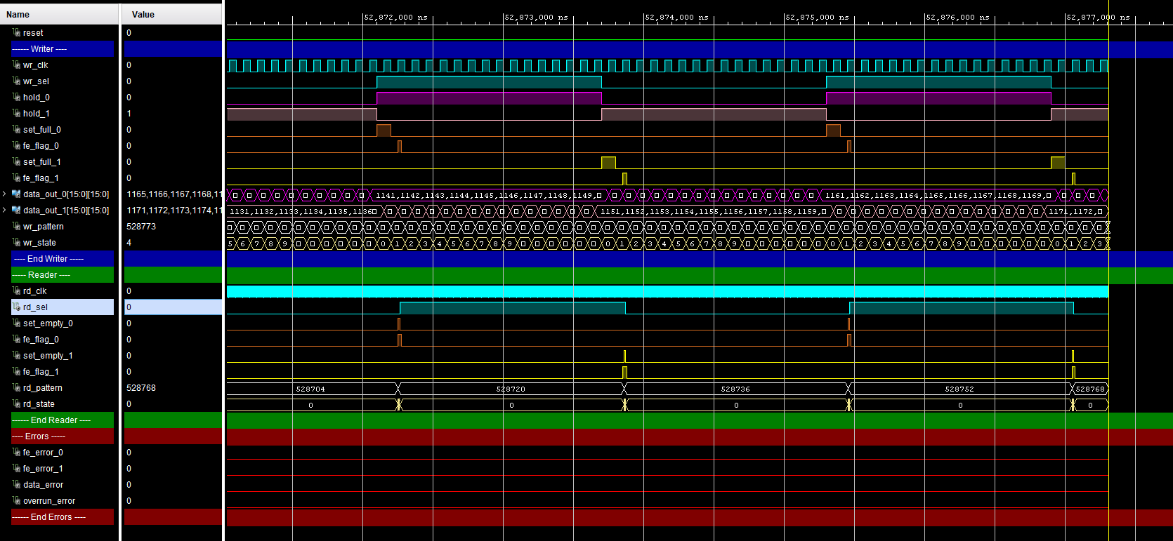
Simulation Results
Success, no errors under various scenarios
Also implemented a more complex simulation with two writer without errors

Slide 52
FPGA Testing Setup
256x256 25-bit pixel buffer @ 250hz
HDMI
Send data from NUCPC
Image / Random CRC Data
UART
Send 1 byte commands
Receive information
Error bits
Current Image (not synchronized)
64-bit Hardware counter Information
Number of pixels received
Number of clocked out 16-pixel buffers
NUCPC
HDMI
ZYBO
UART TX/RX

Slide 53
FPGA Testing Setup Cont.
Error Signals
FE_error : set_full and set_empty occurring at the same time
Overun_error : Writer overran reader and stalled
Addr_in_error : Compare HDMI_addr to internal Writer_addr to make sure no bits were dropped
CRC_error : flag invalid data error

Slide 54


FPGA Testing: Specific tests
Two tests
Static image (visual inspection)
Verify all data using random CRC-like data
0-255 random value for each byte of RGB tuple
Second Test details
Checker Image
R0
R1
R2
R3
R4
R5
R6
R7
R0
R1
R2
R3
R4
R5
R6
R7
Random CRC-like Noise
16 pixel buffer

Slide 55
Results
Reminder
256x256 @ 250hz
Static Image Test
Looks good
Validity Test with random input every frame
No errors
7.11 trillion pixels processed correctly
444 billion 16-pixel buffers clocked out correctly
Ran for ~5 days

Slide 56
Conclusion & Remaining Work
Conclusion
Developing a Packetizing Display Protocol (PDP) architecture of IRLED Array Projectors Systems to enable high-speed operation.
Remaining Work
Finish Implementing Backend Architecture
Test with Arrays (1024x1024, 512x512)
Demonstrate variable frame-rates with a high speed test cases (400hz) not capable of operating using classical display protocols.

Slide 57

Thanks

